Slide 1

Rod-Cutting
CLRS Chapter 15.1, 15.3

Slide 2
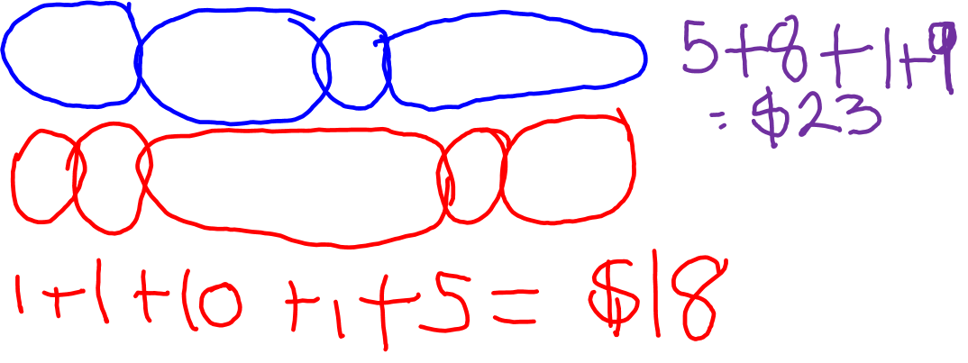
Rod Cutting Problem
Given a rod of length n, cut rod into pieces, sell independently
Pieces are priced based on their size.
Goal: Find the best way of cutting that maximizes our profits.
2+3+1+4 profits =
1+1+5+1+2 profits =
Length i | 1 | 2 | 3 | 4 | 5 | 6 | 7 | 8 | 9 | 10
Price p_{i} | 1 | 5 | 8 | 9 | 10 | 17 | 17 | 20 | 24 | 30

Slide 3

A Divide-and-Conquer Approach
After I cut my first piece, I have the rest of the rod to cut.
Rest of the rod: smaller subproblem.
But how do I make that first cut?
Try all possible ways.
Idea: Cut first piece and solve the rest recursively

Slide 4


Recursive Divide-and Conquer
Cut-rod(p,n)
If n == 0 return 0;
q = 0
for i = 1 to n
q = max(q, $p[i]$+ Cut-rod(p,n - i))
Return q

Slide 5
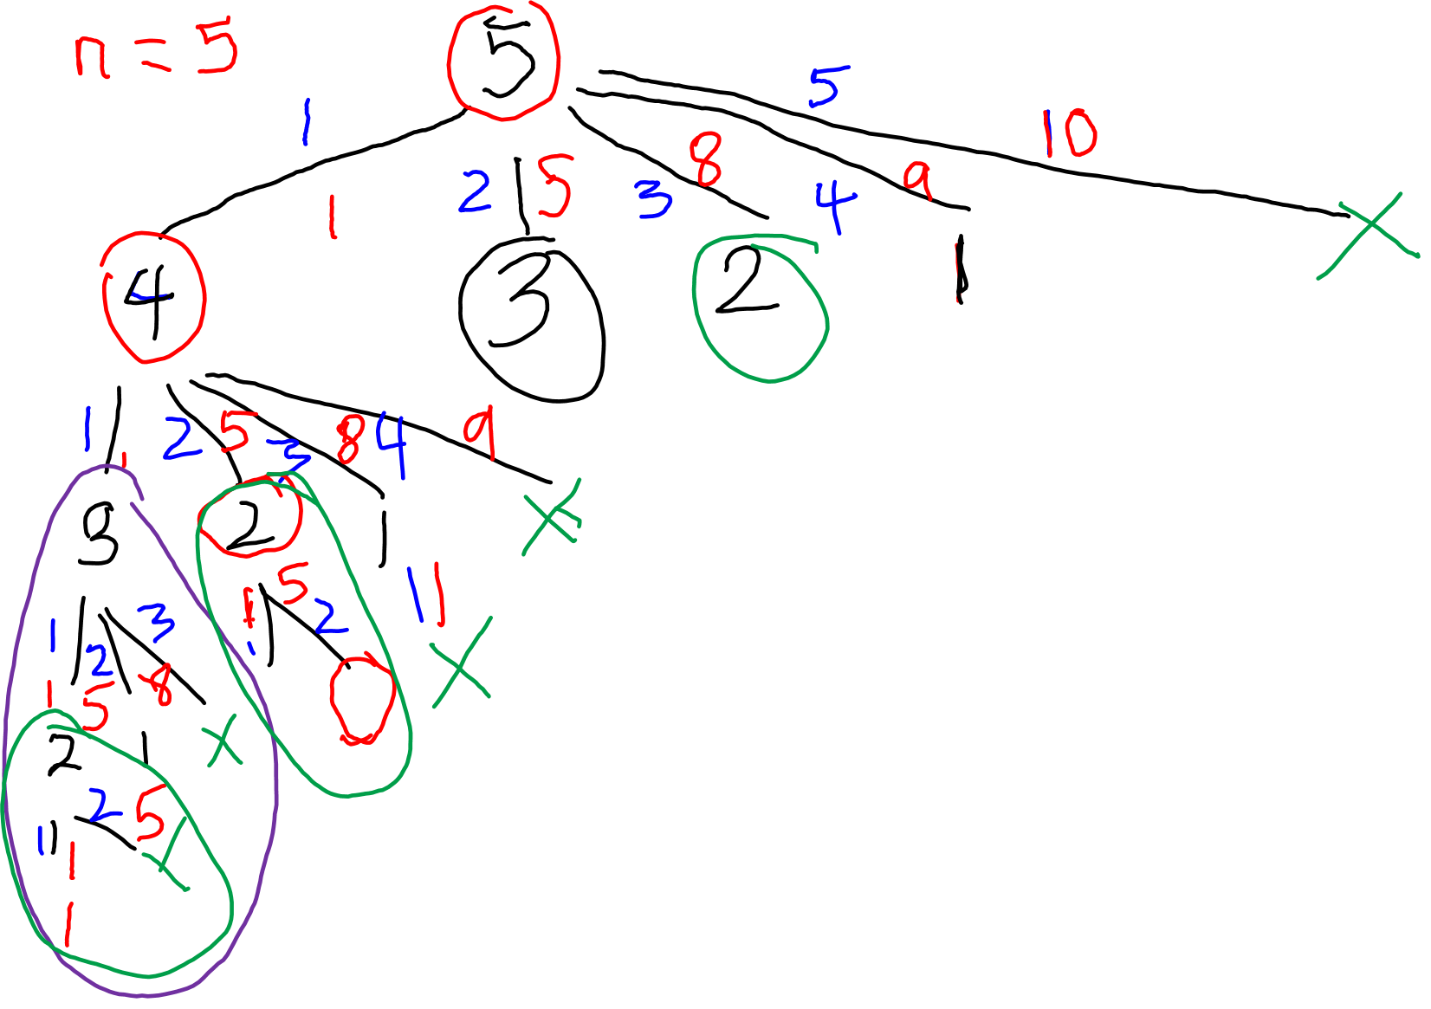

Slide 6
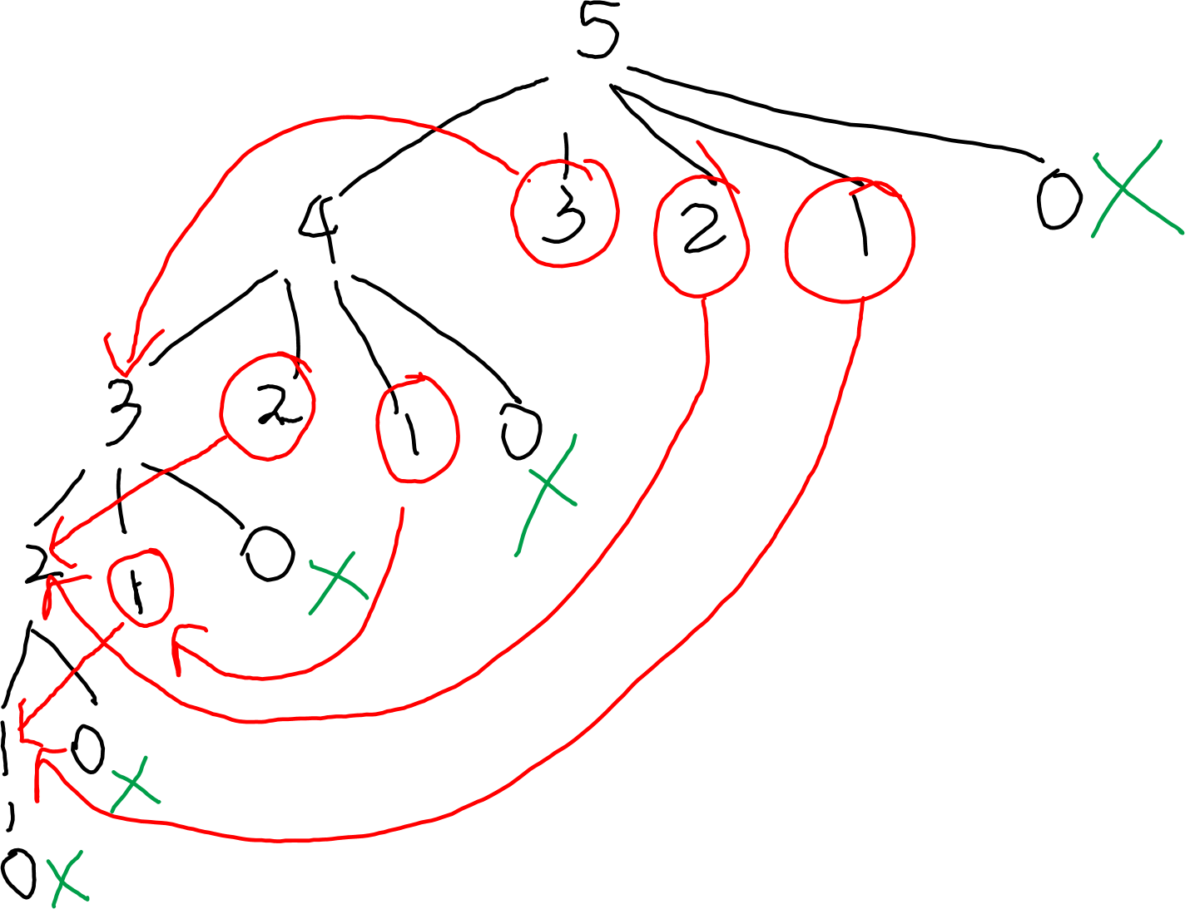

Slide 7
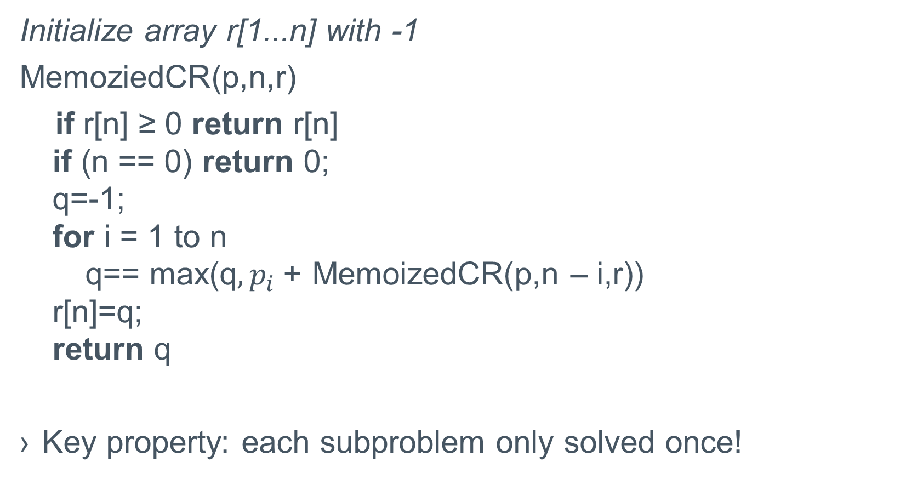
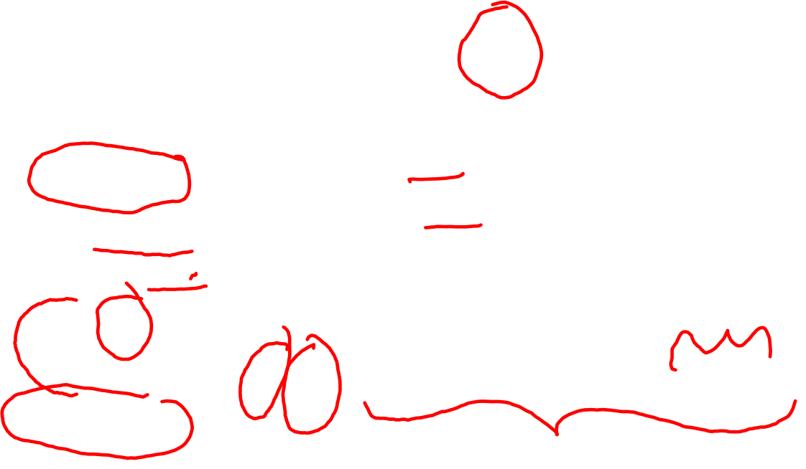
A Better Way
Initialize array r[1...n] with -1
MemoziedCR(p,n,r)
if r[n] ≥ 0 return r[n]
if (n == 0) return 0;
q=-1;
for i = 1 to n
q== max(q$, p_{i}$+ MemoizedCR(p,n – i,r))
r[n]=q;
return q
Key property: each subproblem only solved once!

Slide 8
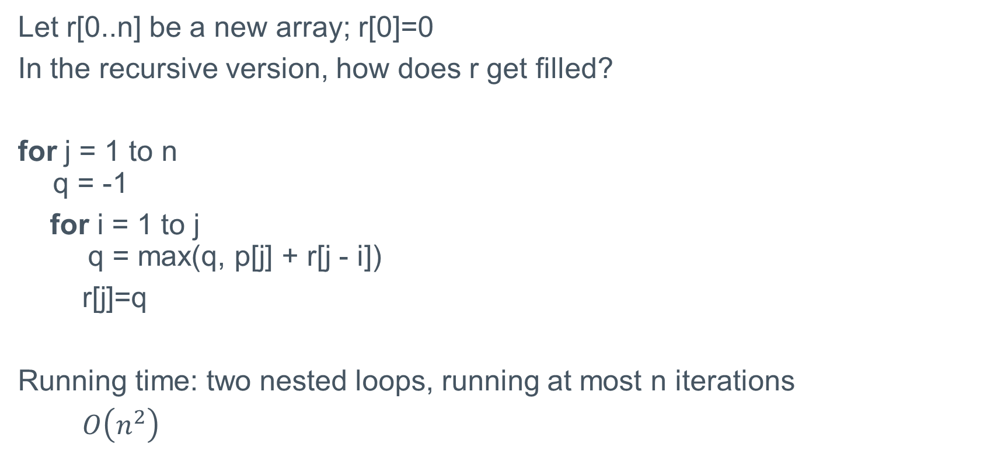
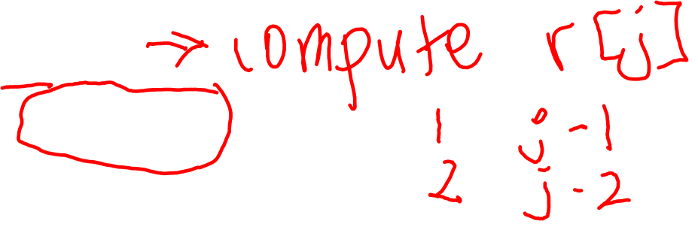
Bottom Up solution
Let r[0..n] be a new array; r[0]=0
In the recursive version, how does r get filled?
for j = 1 to n
q = -1
for i = 1 to j
q = max(q, p[j] + r[j - i])
r[j]=q
Running time: two nested loops, running at most n iterations
$O\left(n^{2}\right)$

Slide 9
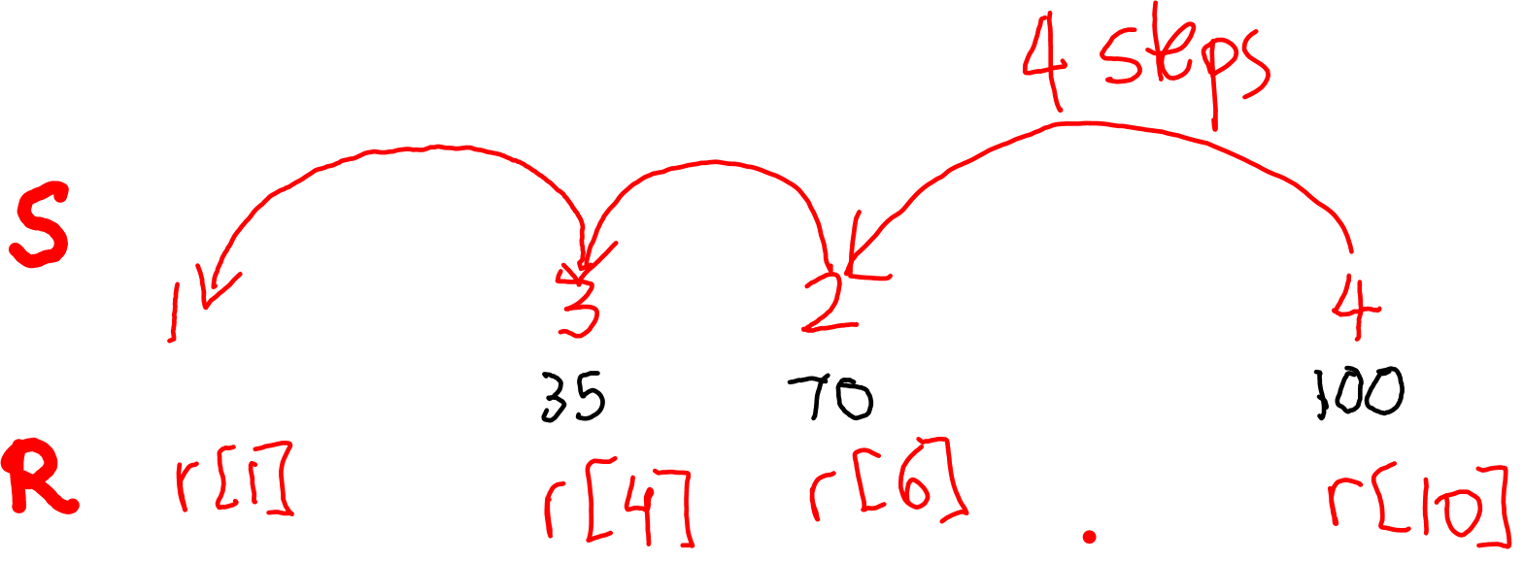
Reconstructing Solution
P. 369
Cut
Profit

